Slide 1
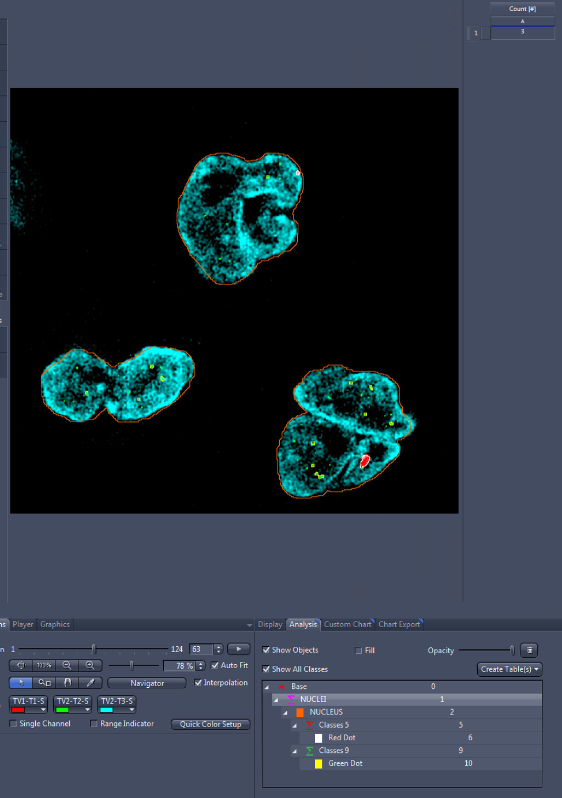
Total number of Nucleus

Slide 2
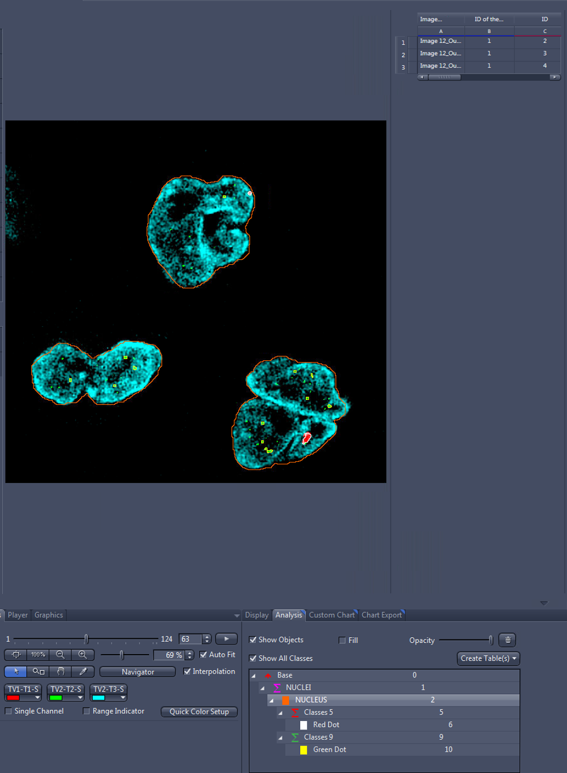
3 nuclei:
All belong to Parent 1 (Sum of Nuclues)
ID:
2
3
4

Slide 3
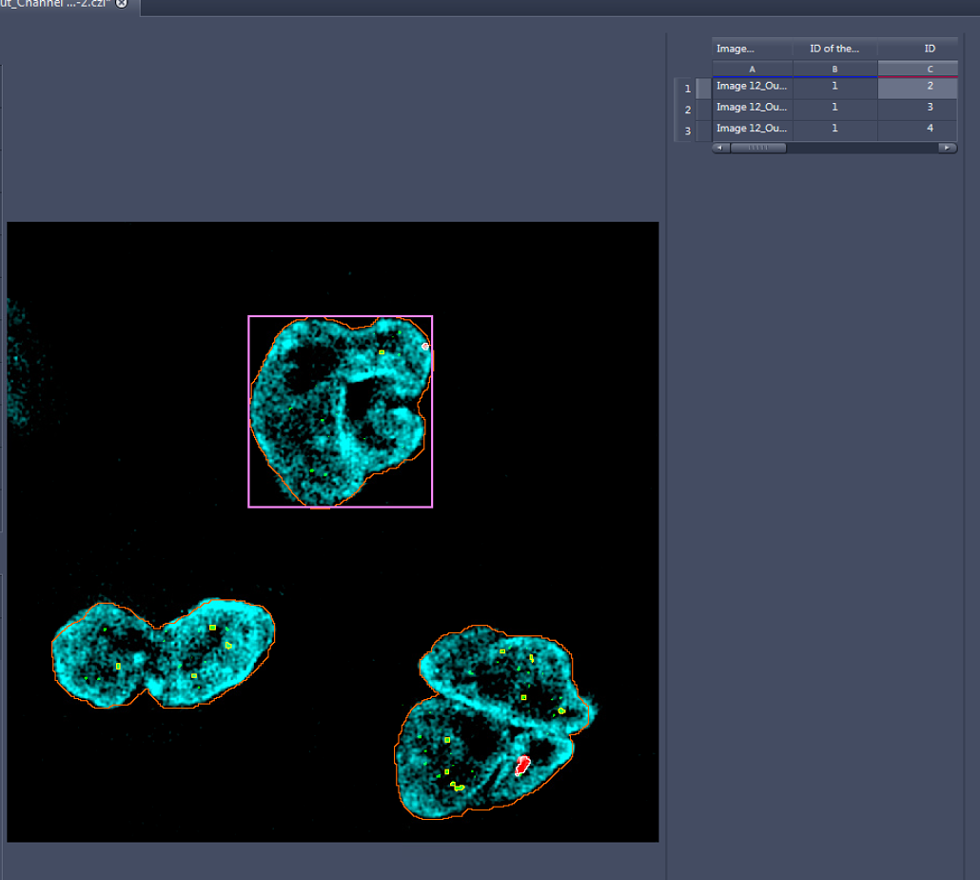
Nucleus ID: 2
ID:
2

Slide 4
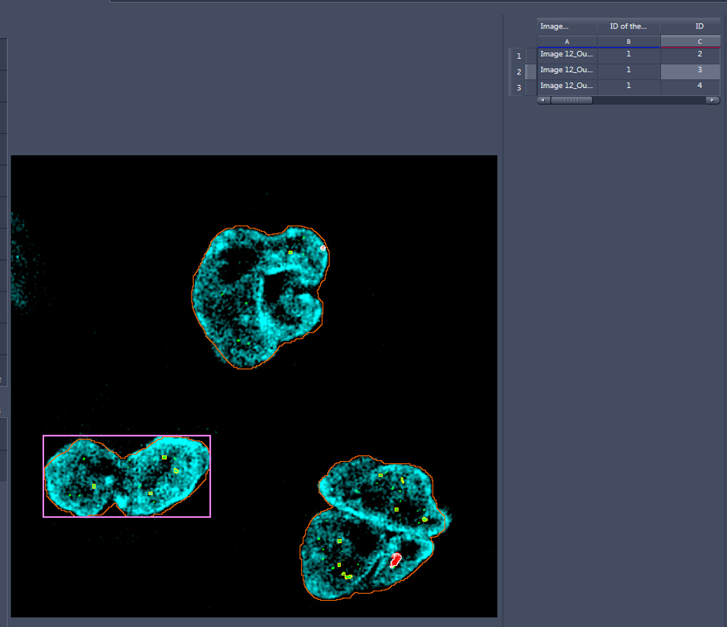
Nucleus ID: 3

Slide 5
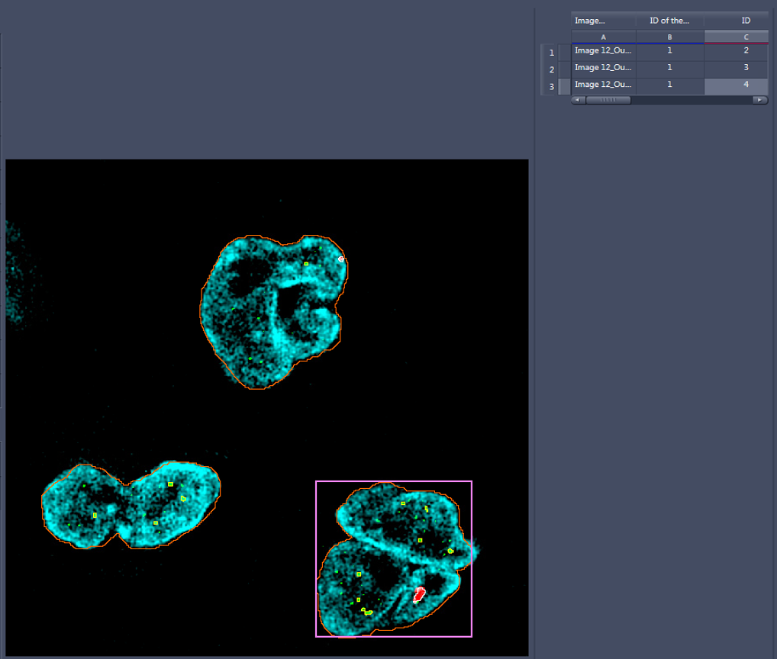
Nucleus ID: 4

Slide 6
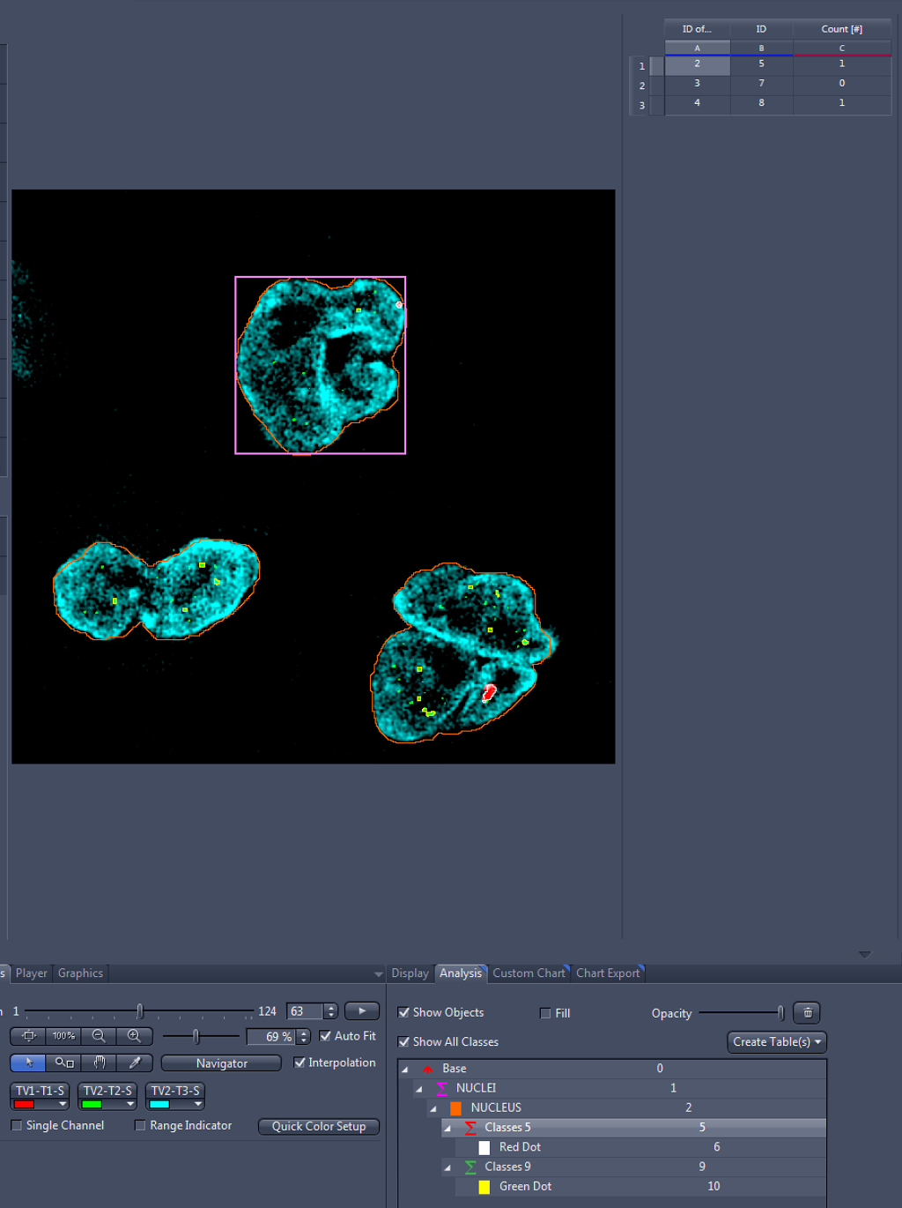
Sum of red dots:
Each sum has an ID:
ID5: sum of red dots (=1) in nucleus 2 (2: ID of parents)
ID 7: red dots sum (0) in nucleus ID 3

Slide 7
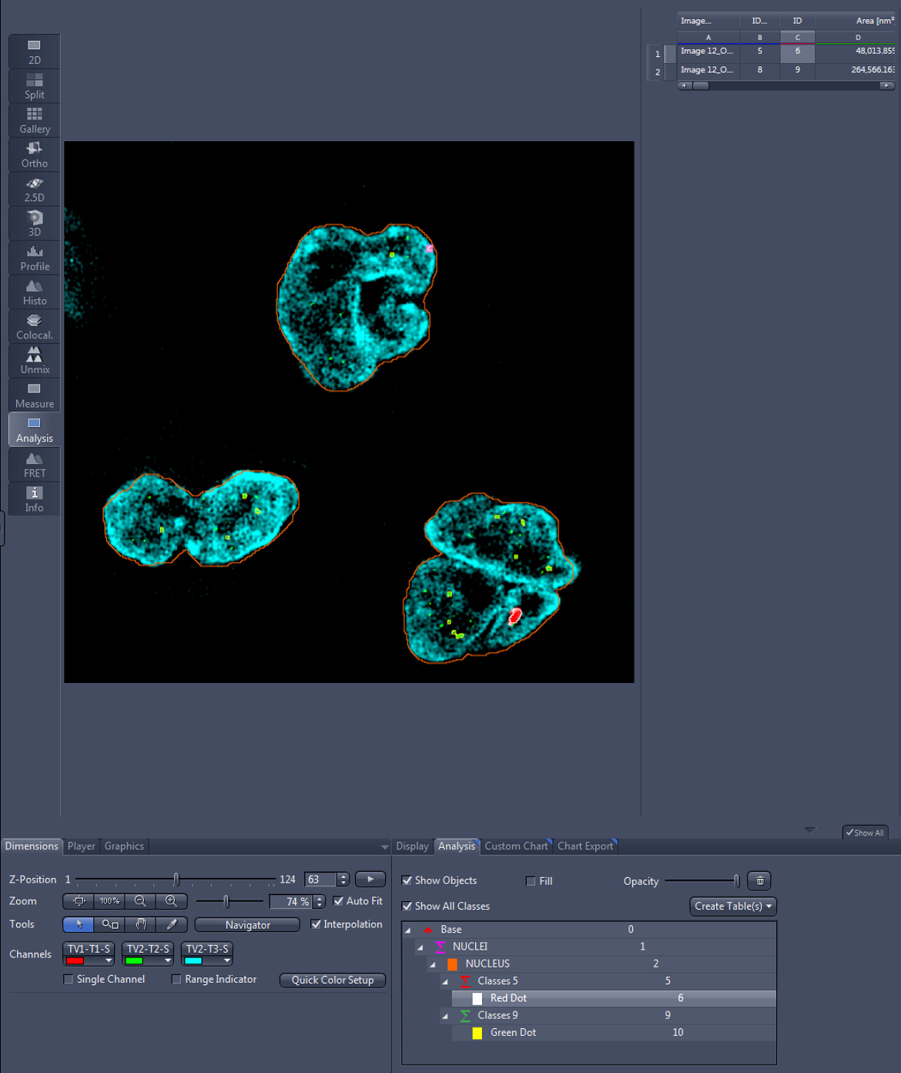
Individual dots:
Red dots ID 6 belongs to ID parent 5 (sum of red dots in nucleus number 2)

Slide 8
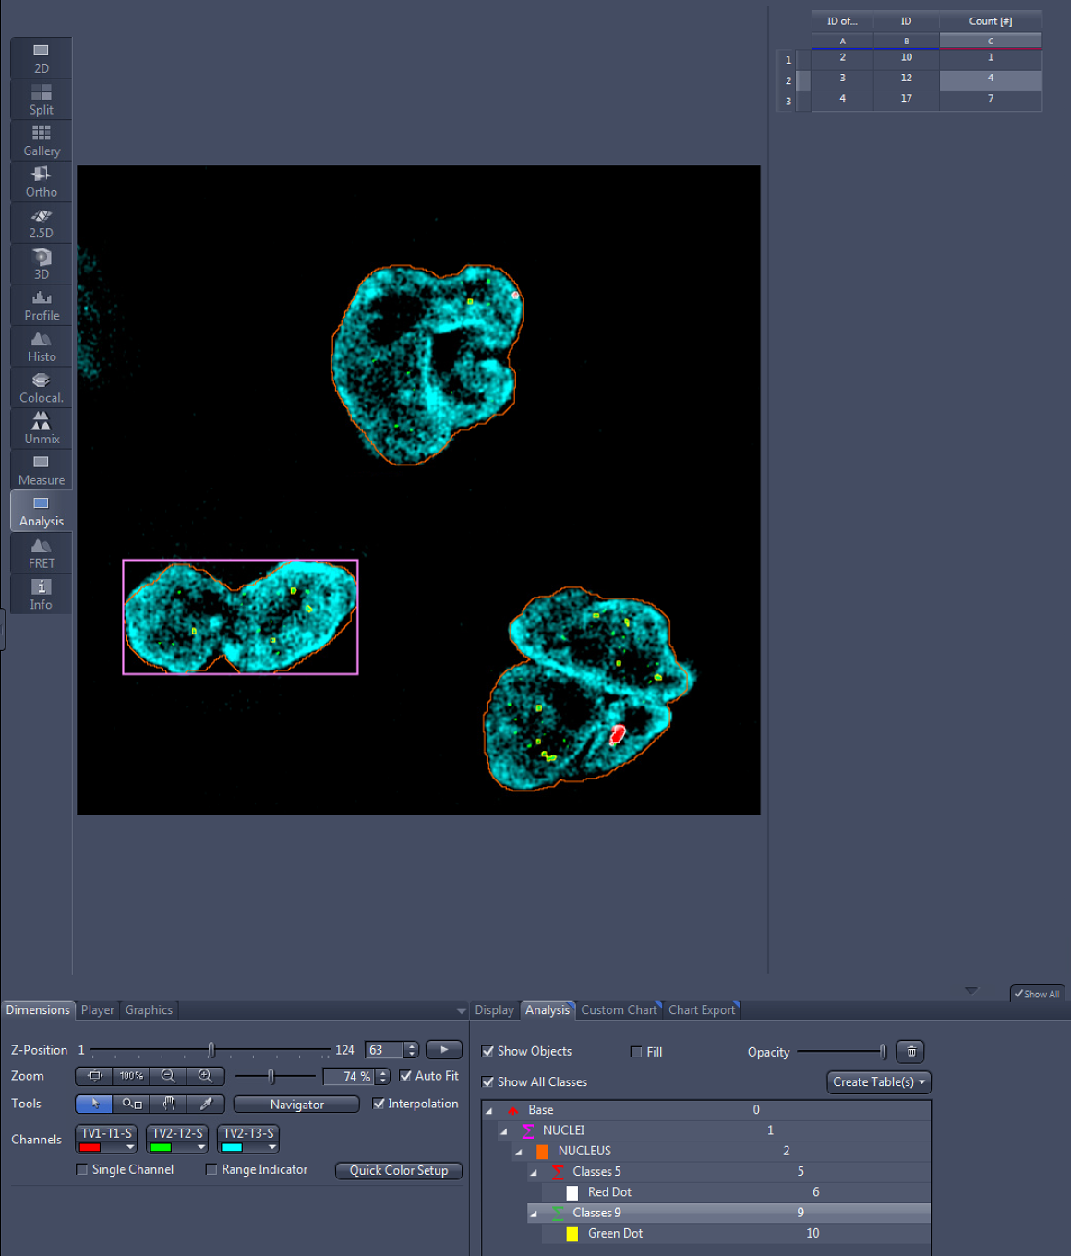
Sum of green dots:
ID 12: sum of green dots (=4) in nucleus ID number 3; ID of parent )

Slide 9

Individual green dots:
ID 13: green dots belongs to ID parent 12 (sum of red dots in nucleus number 2)

